Slide 1

ARENA-PAC & AI3/SOI-ASIA collaborate/cooperate with APAN community
Hiroshi Esaki (Hiroshi@wide)
Hirochika Asai (panda@wide)
Takashi Tomine (tomine@wide)
Husni Thamrin (husni@wide)

Slide 2
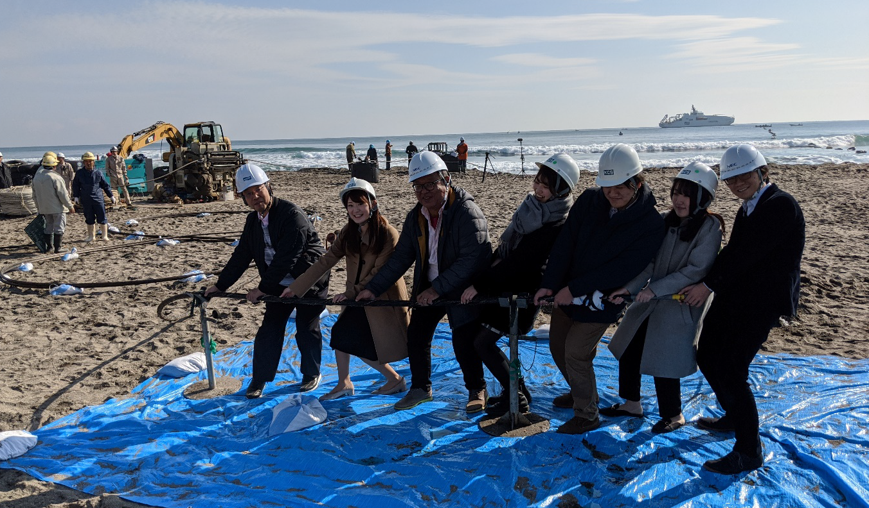
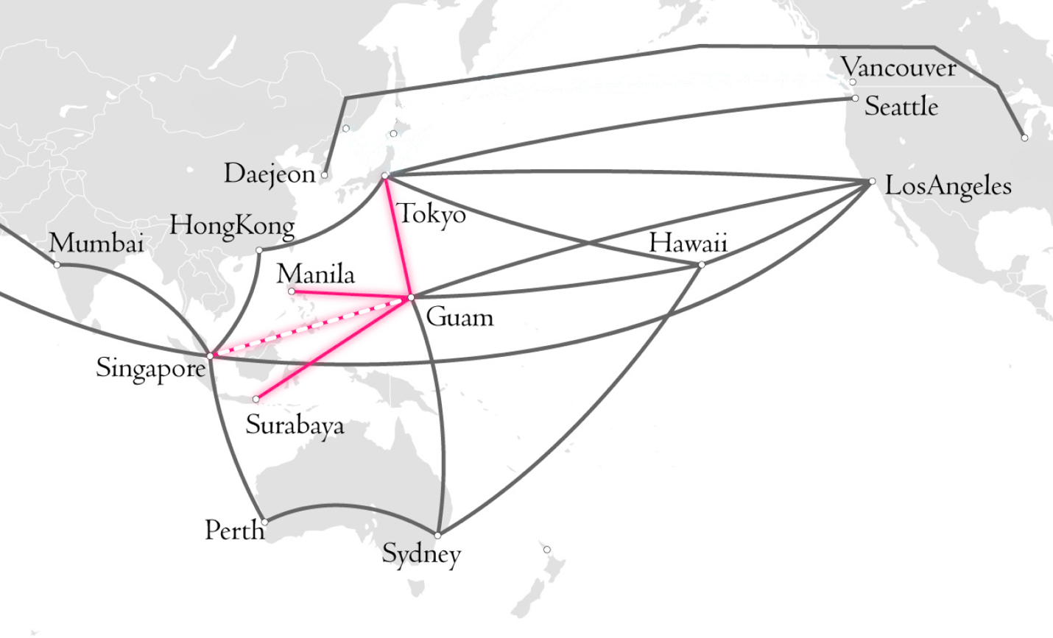
ARINA-PAC
Arterial Research and Educational Network in Asia-Pacific
ARENA-PAC (arena-pac.net)

Slide 3
ARENA-PAC is a new regional backbone network of high-capacity international submarine cable circuits, serving NRENs at multiple locations in the Asia Pacific. It will comprise several long-term IRU circuits, of 10 and 100Gbps, between a central exchange point in Guam and sites in Tokyo, Philippines and Indonesia. All circuits will be leased from regional cable companies including RTI Cables and others.
ARENA-PAC is a project of APIDT Infrastructure Pty Ltd, and funded entirely by the APIDT (Asia Pacific Internet Development Trust).
Management Committee
  Prof Jun Murai, WIDE Project / KEIO University
  Paul Wilson, APNIC
  Che-Hoo Cheng, APNIC
WIDE Project is discussing new high bandwidth connectivity to Europe.

Slide 4
WIDE
Vehicle for Design, develop, deploy and operate advanced networks by ourselves for ourselves, i.e., multi-stake-holder R&D/D&E platform
Researches in
Academic
domain
Researches in
Industrial
domain
Research Output
Government
Direct Contribution
Direct Feedback
SOCIETY

Slide 5
Mission and deliverables of platform referencing/sharing IPv6 in Japan and AI3/SOI-ASIA
R&D (Development and Deployment) for advanced technologies and applications over the global Internet
Capacity Building with real system, i.e., education for academia and for industry
Deliver and share the best practices
Award/certificate and share the valuable experiences
Establishment of ”Interoperability”

Slide 6

ARENA-PAC Operations
ARENA-PAC (AS141682)
Interconnection with other research and educational networks (RENs)
  Tokyo
    WIDE Project (AS2500)
  Guam
    Univ. of Hawaii (AS35889)
    GOREX partners
      UoG, AARNet, SingAREN, etc.
Research/educational traffic delivery
Research collaborations on ARENA-PAC and interconnected RENs
ARENA-PAC is open for peering!

Slide 7
AI3/SOI-ASIA

Slide 8
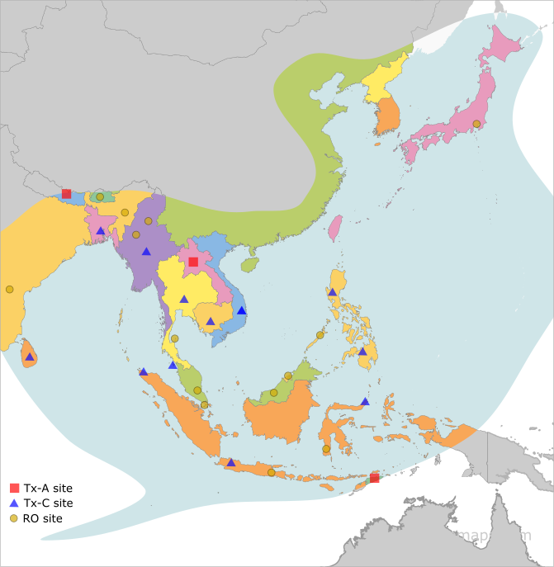
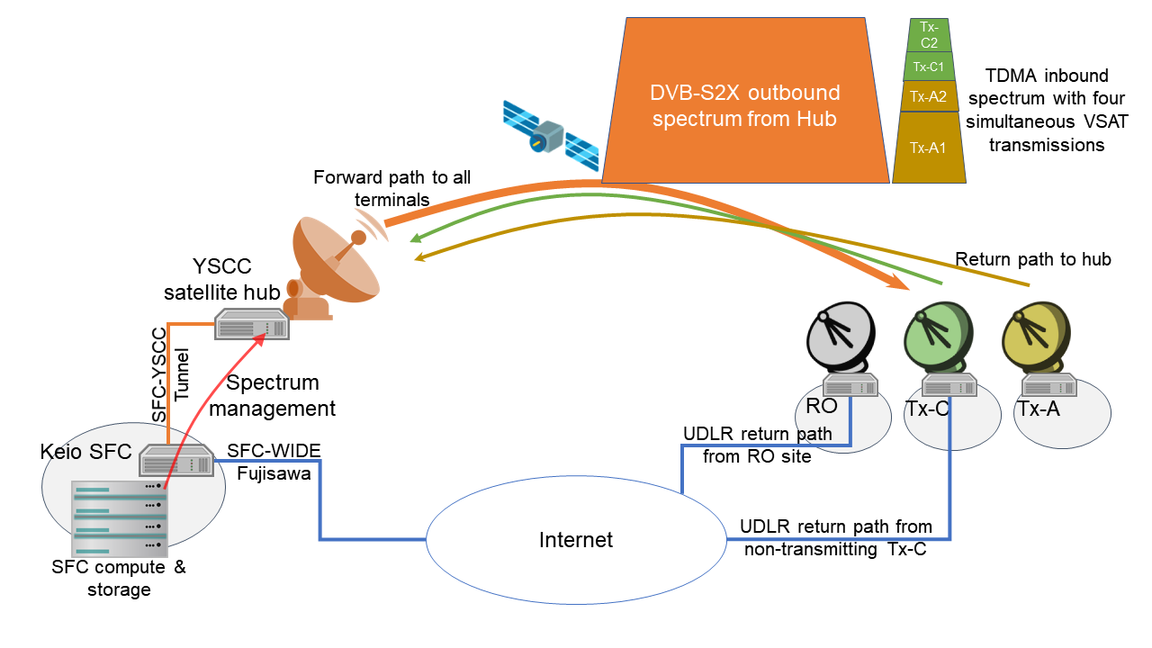
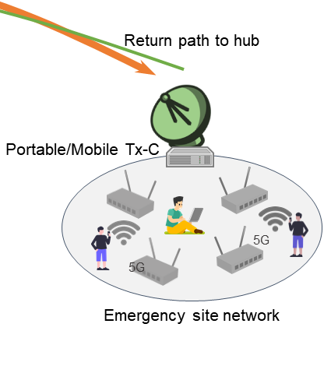
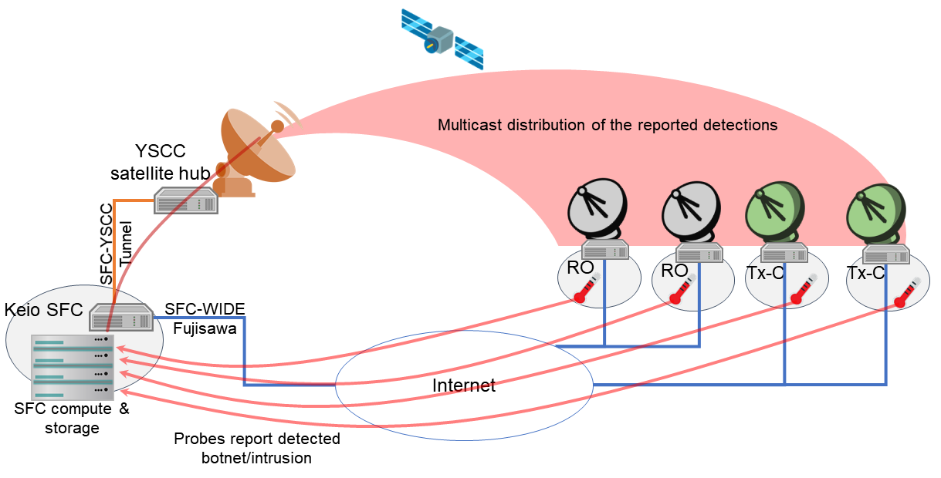
Asian Internet Interconnection Initiatives
I. Satellite Internet infrastructure
II. Research
A. Developing a VSAT satellite internet with unidirectional link routing
B. Developing an emergency-ready network
C. Research and education network technology development and collaborations
Planned SARENA-PAC

Slide 9
SOI Asia Capacity Building Framework
APNIC
UNESCO
A. EBA Programs
AITAC
Content
Partner A
EBA
Faculty Development
Energy and Environment
Health Environment
Disaster and Security
B. Future Internet Engineer Development
University A
………..
Content
Partner Z
………..
Evidence-Based Approach
collaborative project-based learning, internship, and fieldwork
C. SOI Asia Learning Platform
MOOC, learning analytics, federated credentials
University
Z

